Slide 1

People waste soo much Time for buying tickets to visit monument on ticket windows

Slide 2
The problem
Travellers waste time for buying tickets offline
and that’s why they can’t explore everything and people in long queue make things bizarre and bored before see anything.

Slide 3
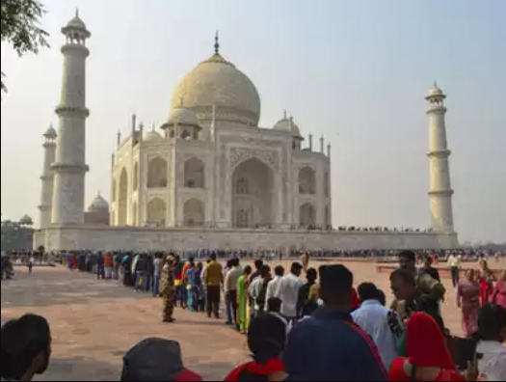

Slide 4
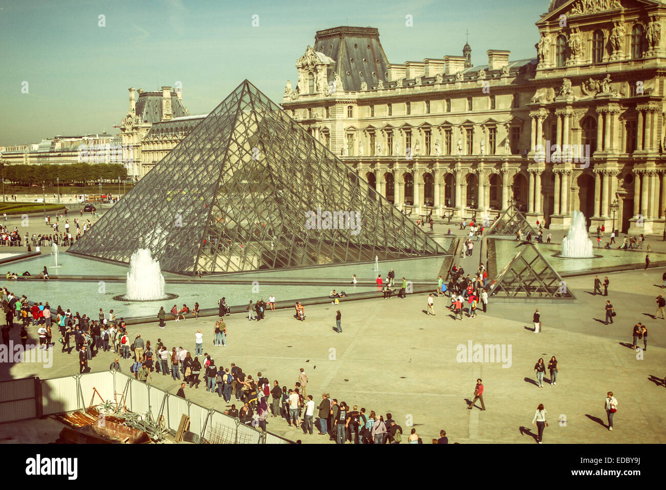

Slide 5

The solution
We can buy ticket online and pay for it online it adds hasslefree experience in your fun.

Slide 6
How it works
Step 3
Make payment and get your paperless tickets
Step 1
Visit our site
Step 2
Select monument you want to see

Slide 7
VISION
We can do statistical analysis by- 1.Which place people like most
2.Which heritage’s ticket people buying in the
season
Collabration with Paytm and other apps
Use consumer behaviour for forecasting

Slide 8
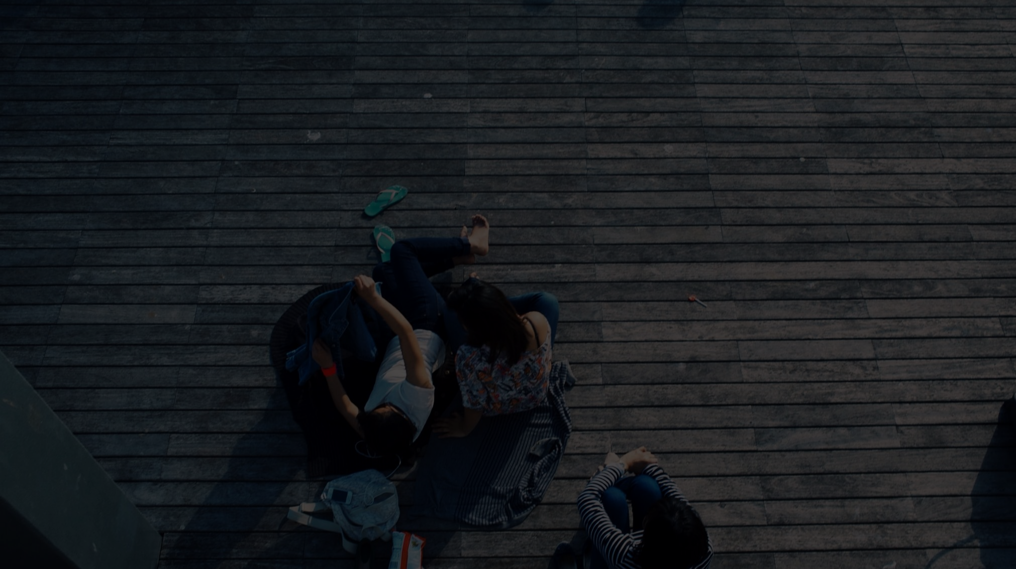
Why now?
Because everyone want a hassle free experience in free time

